Slide 1


Khallikote Unitary University,
Berhampur
Project
On
Library Management System
Guided by:-
Dr. Indrani Kumari Sahu
(Department of MCA)
Khallikote Unitary University
presented by :-
Surya Kanta Dalai
SF23MCA031
3rd Semester
Notes:
1

Slide 2

Contents
Introduction
Requirements
Diagrams
Screen Shots
Future Scope
Advantages
Disadvantages
Conclusion

Slide 3

Introduction
A library is a collection of books, resources, and information materials that are organized, stored, and made accessible for reading, research, and reference.
A Library Management System is a software solution designed to streamline operations and enhance the user experience in libraries. It plays a vital role in modern libraries.

Slide 4

Requirements
Hardware
Software
Modules
User Management Module
Book Management Module
Book Issue & Return Module
Search & Filter Module
Fine Calculation Module
Notification Module

Slide 5
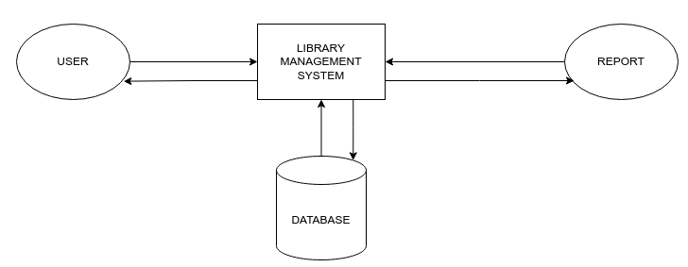
Data Flow Diagram

Slide 6
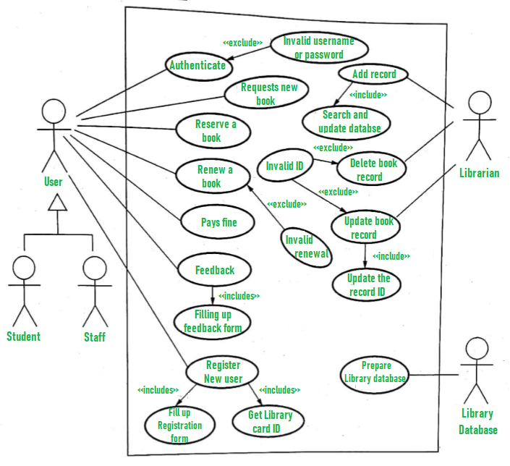
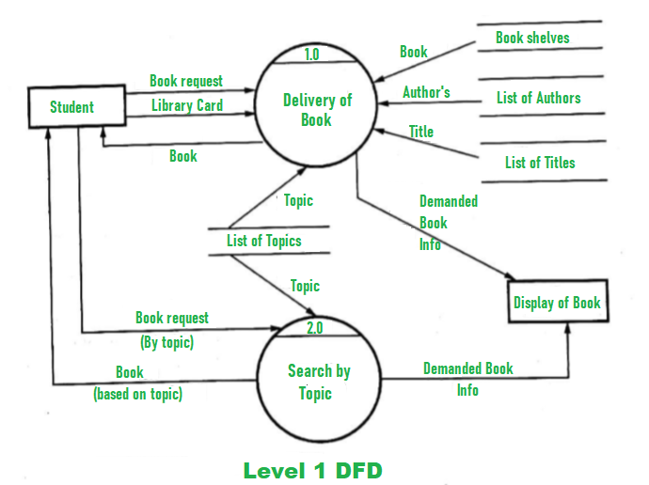
Use Case Diagram

Slide 7
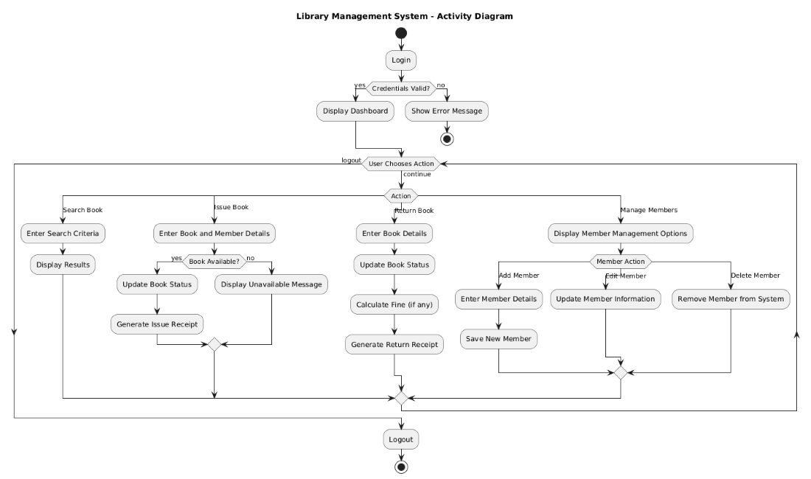
Activity Diagram

Slide 8
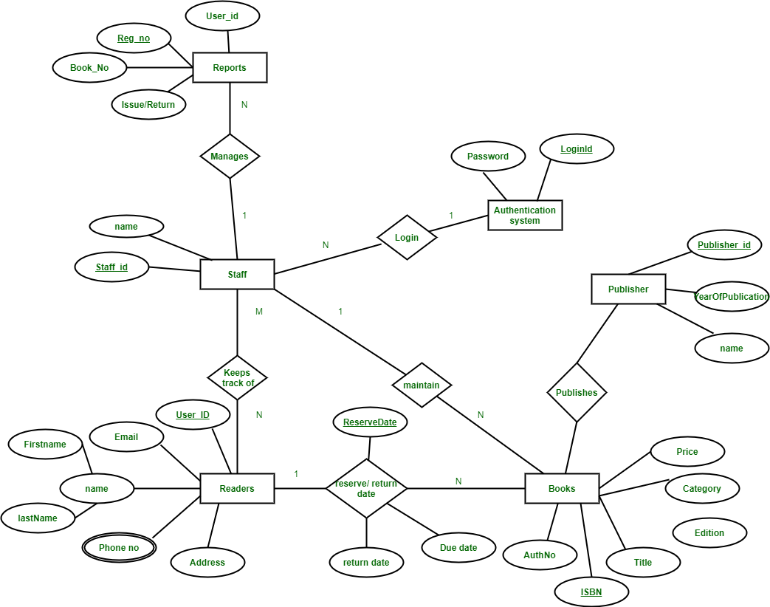
ER-Diagram

Slide 9
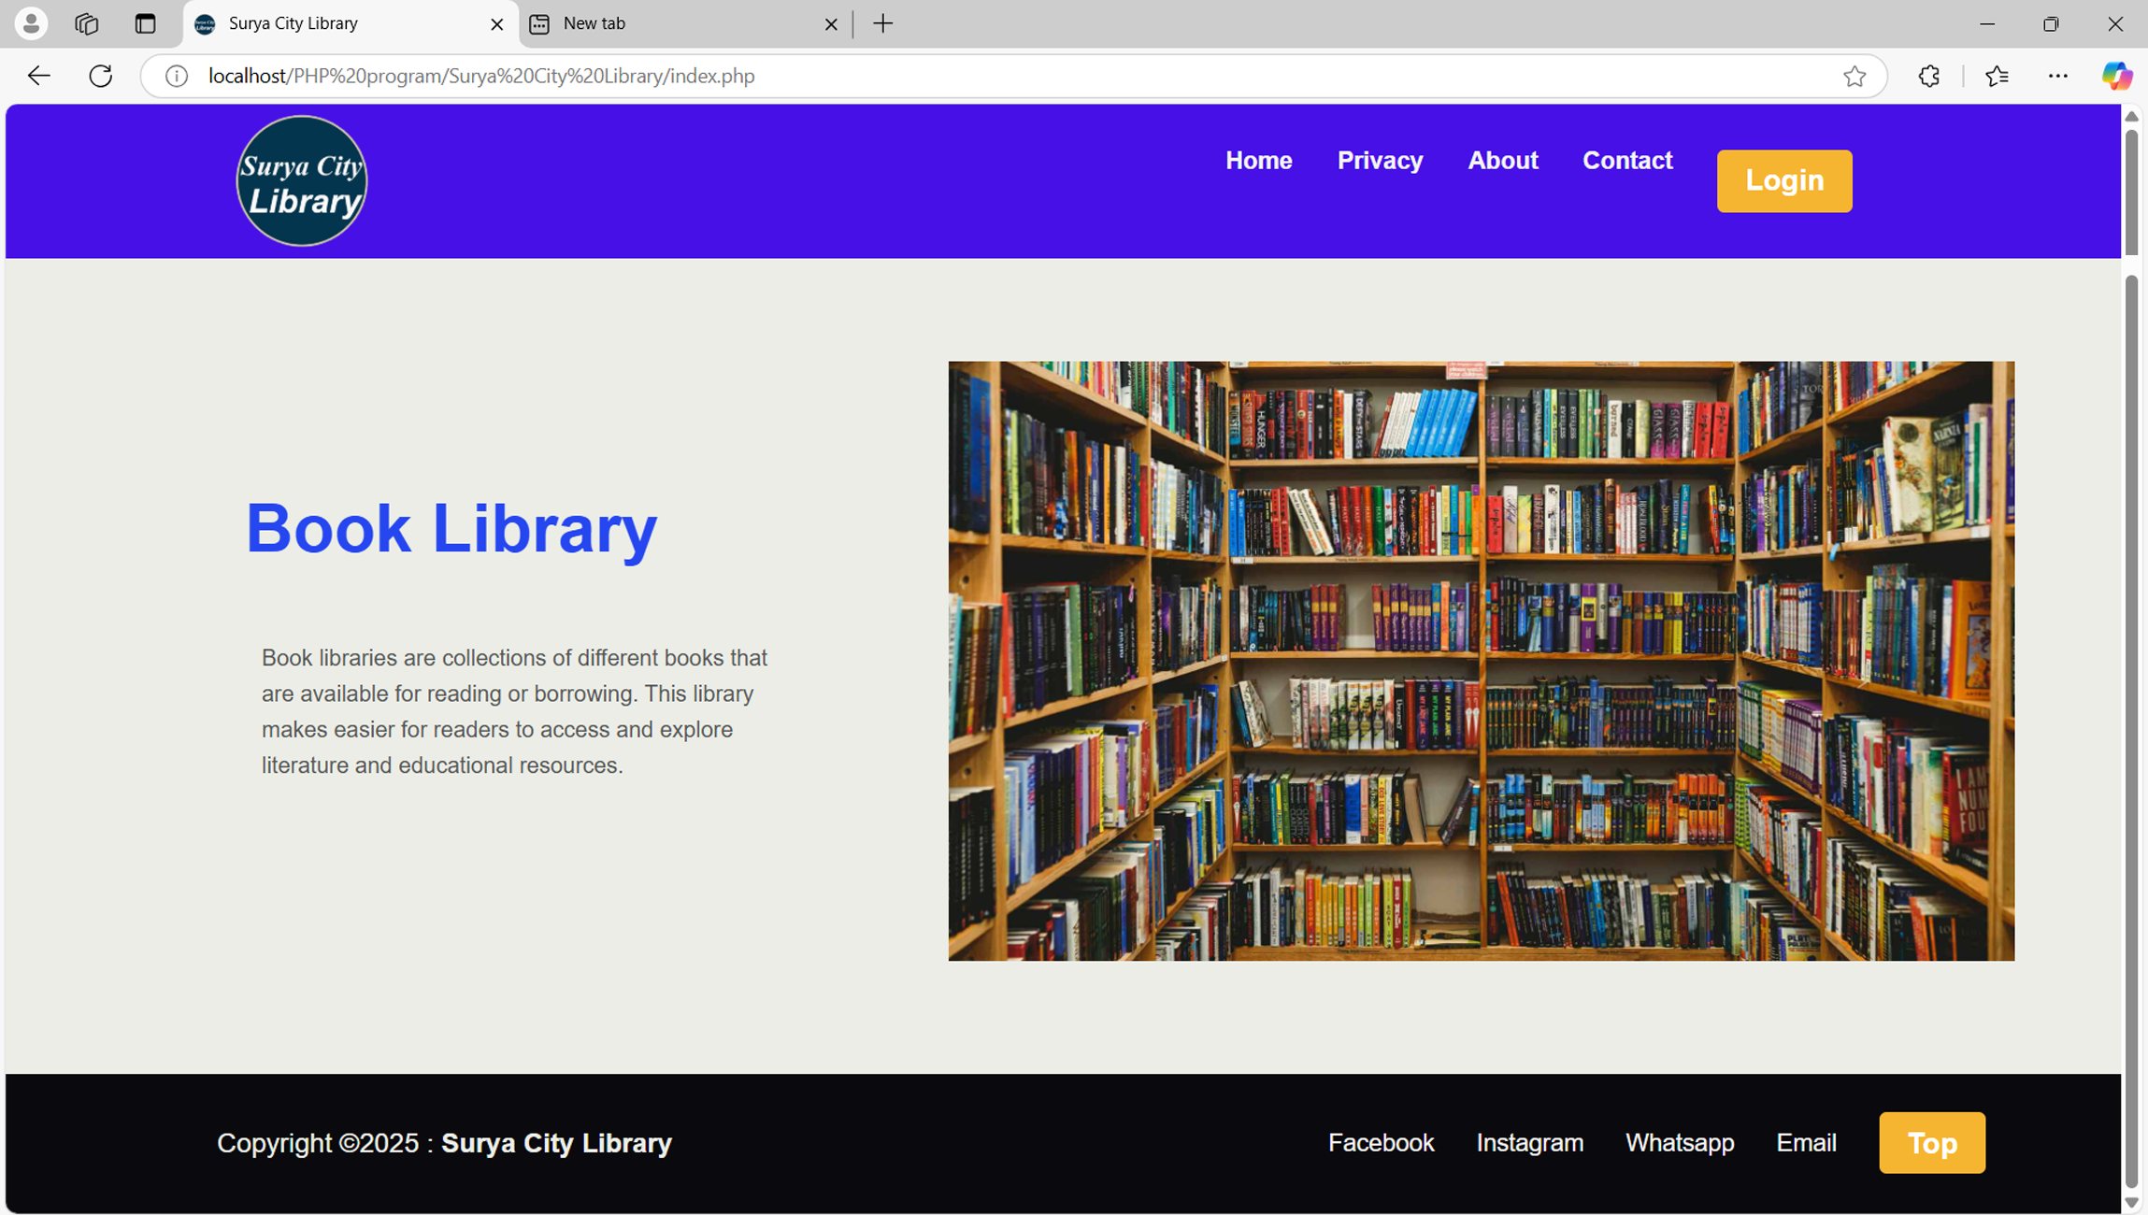
Screen Shots

Slide 10
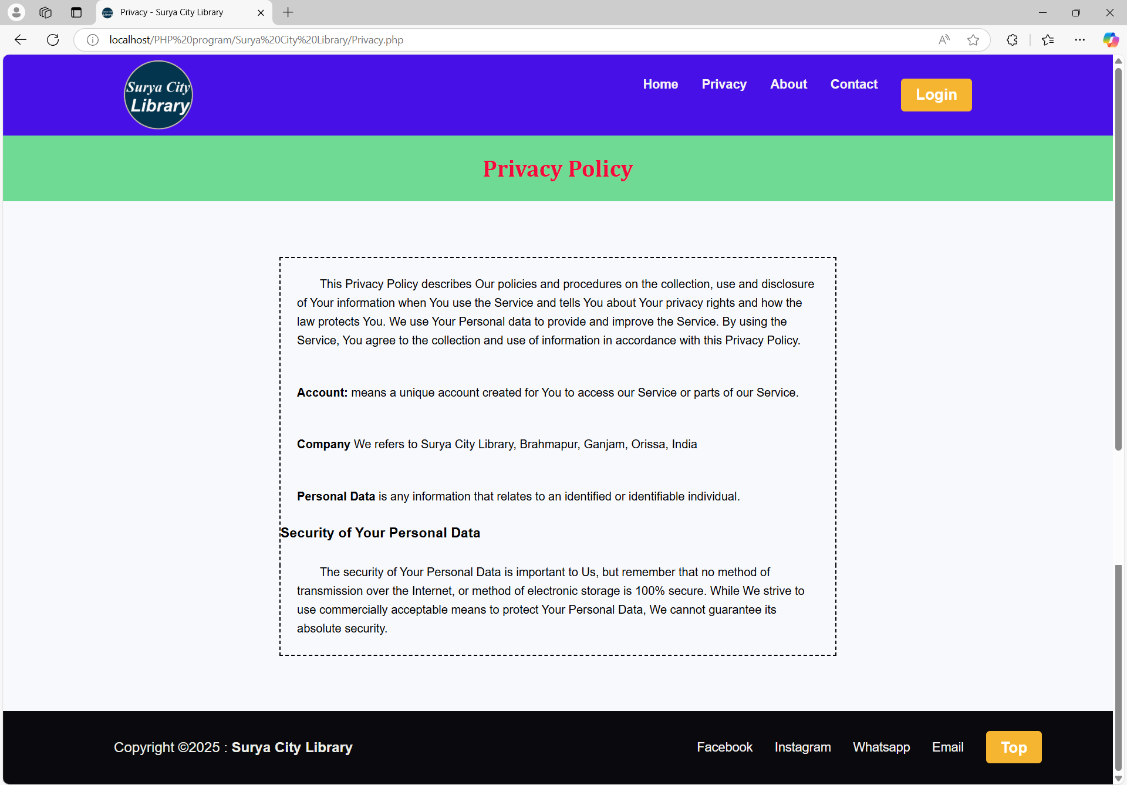

Slide 11
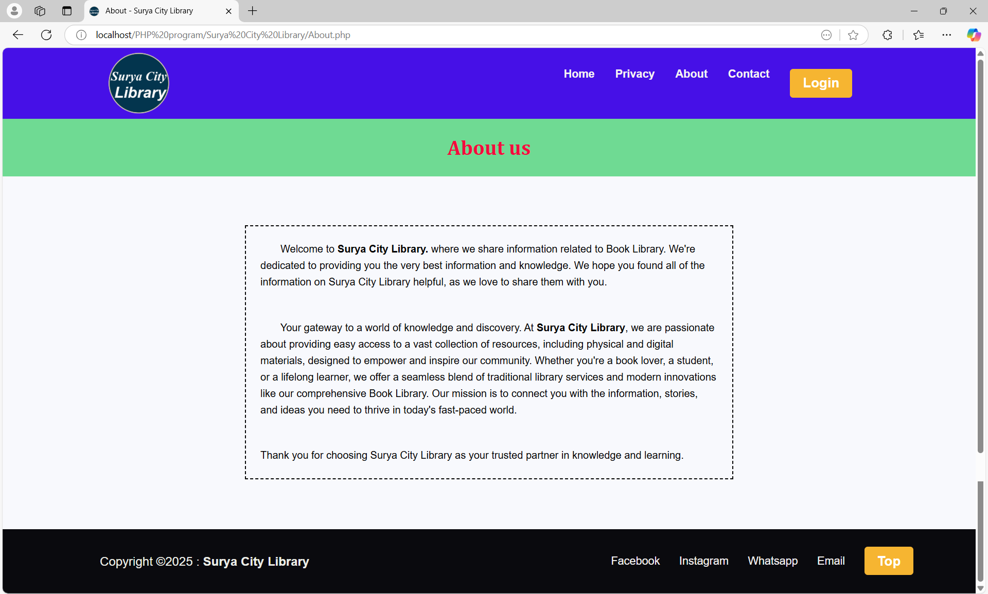

Slide 12
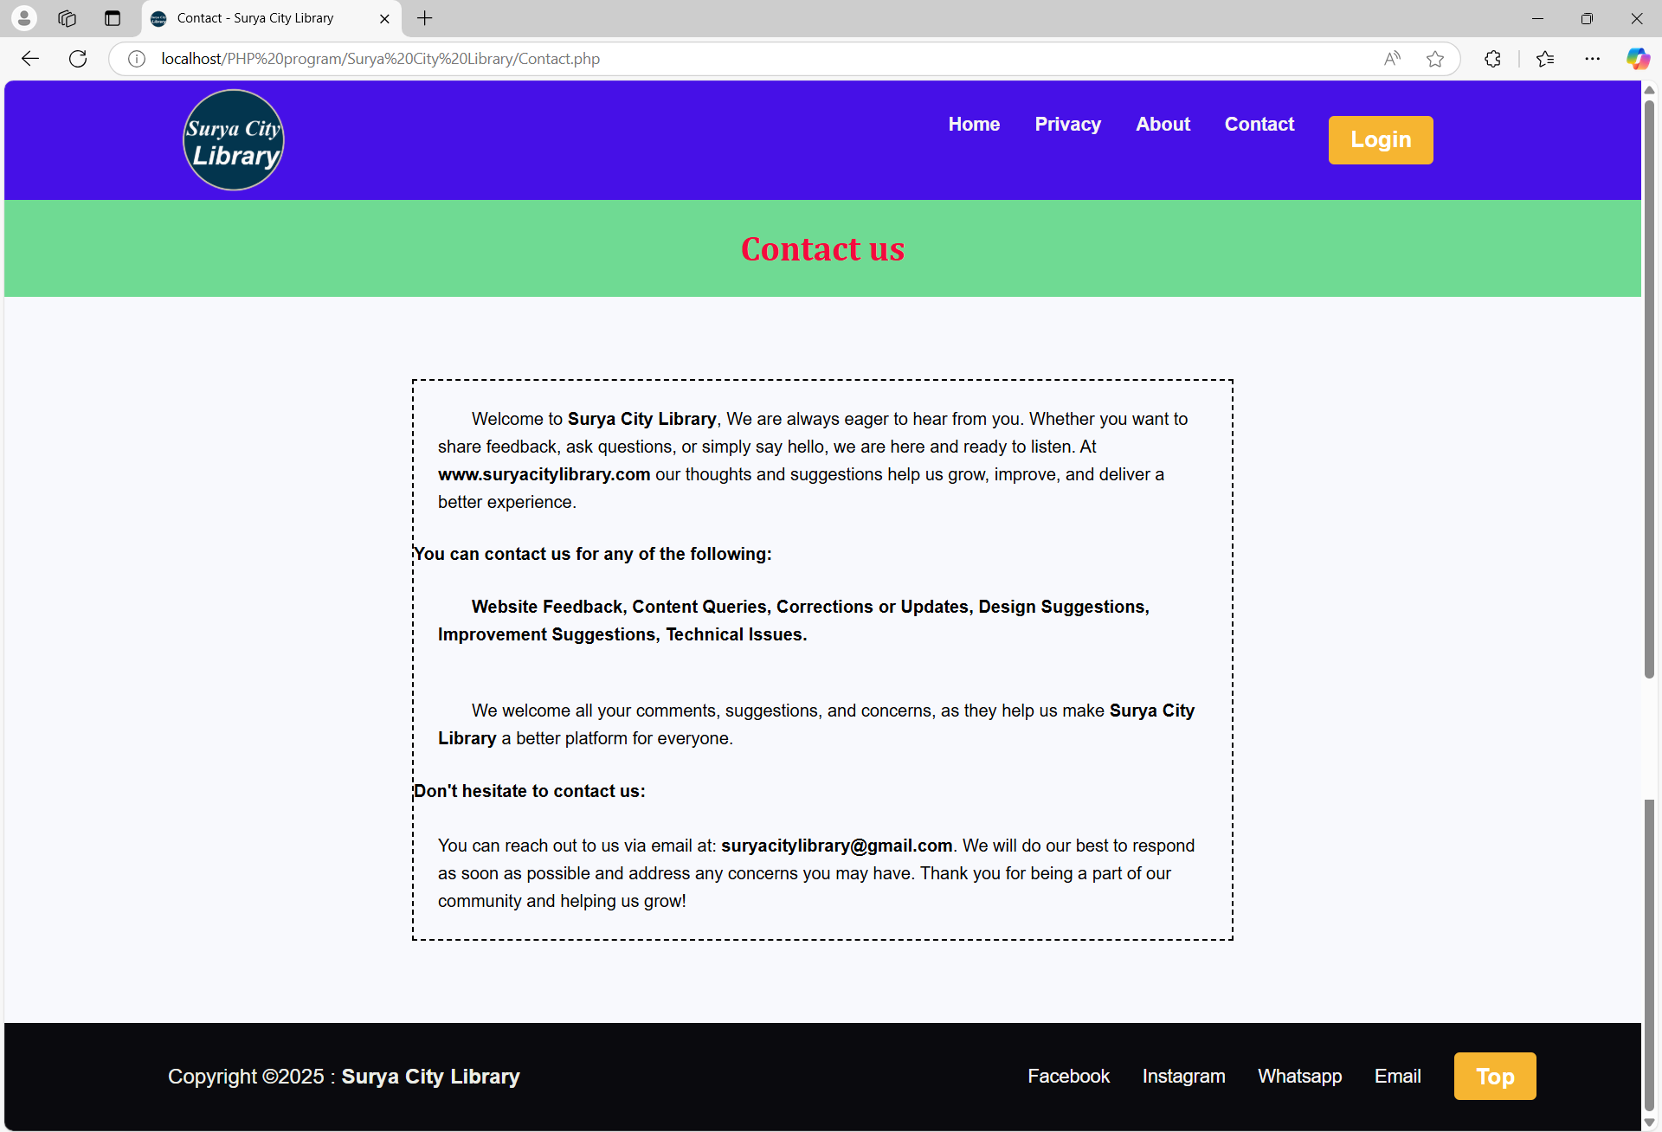

Slide 13
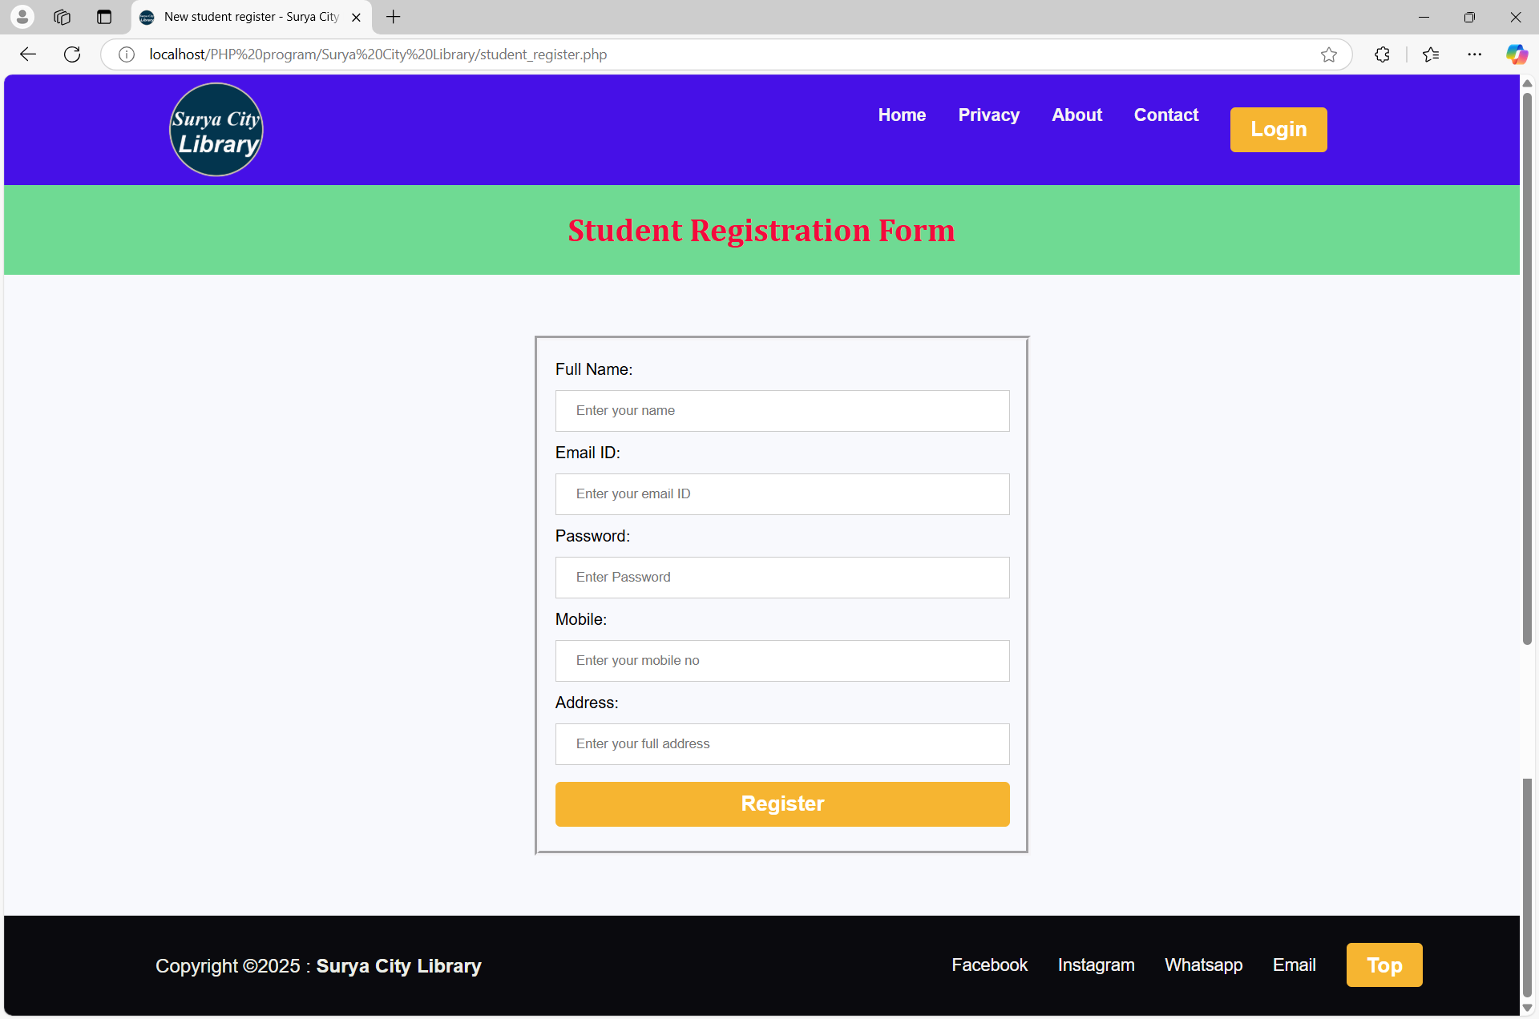

Slide 14
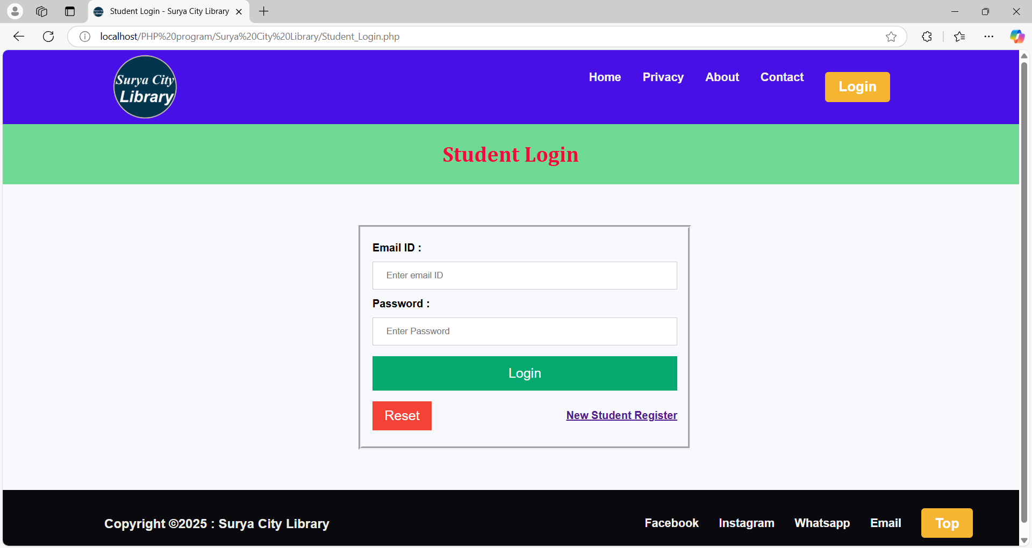

Slide 15
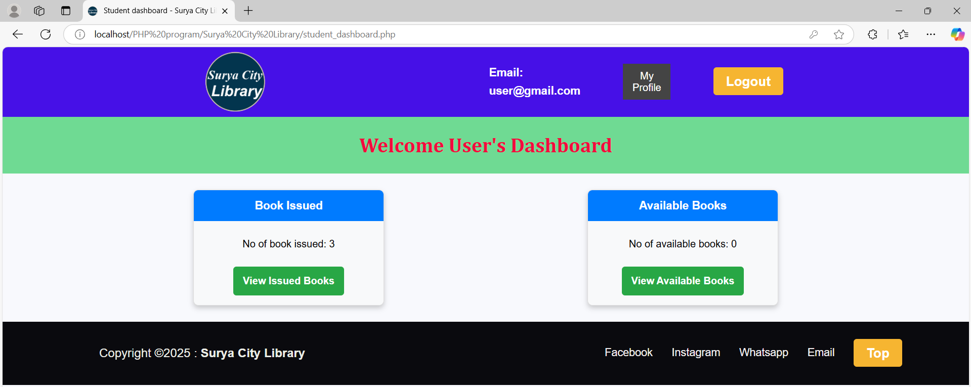

Slide 16
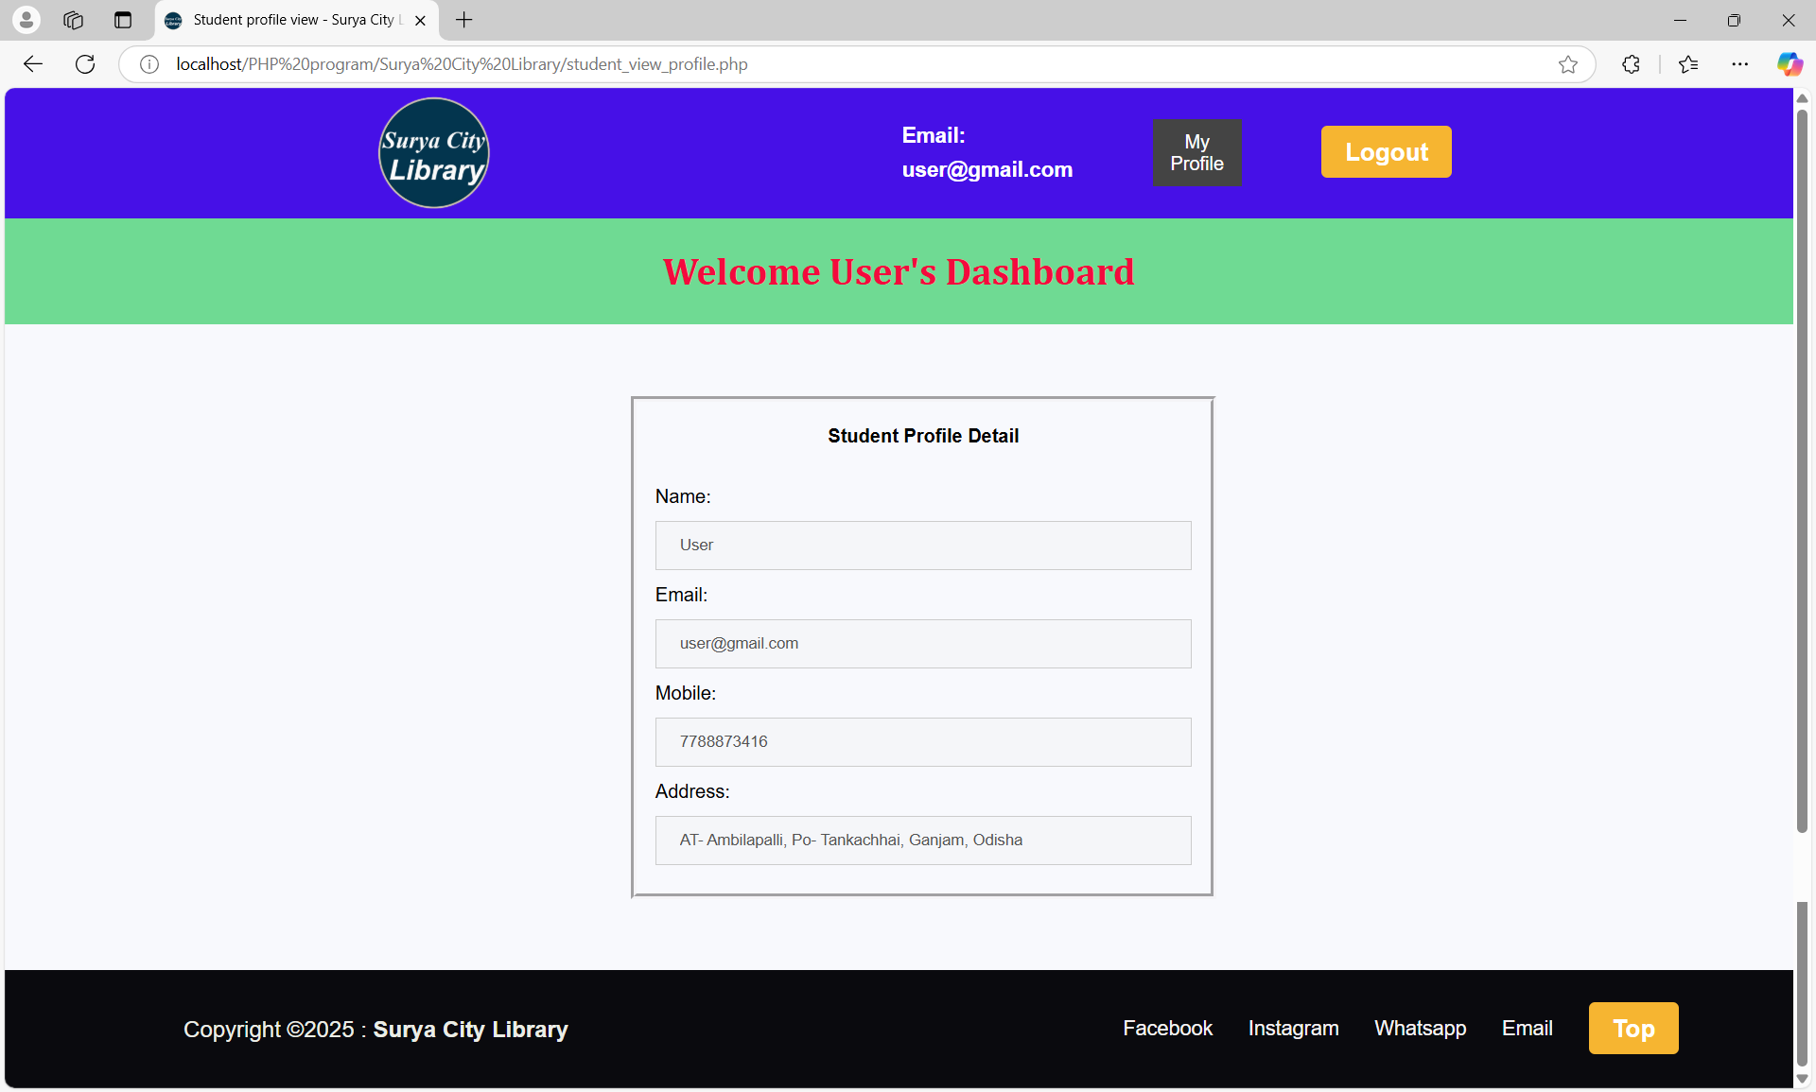

Slide 17
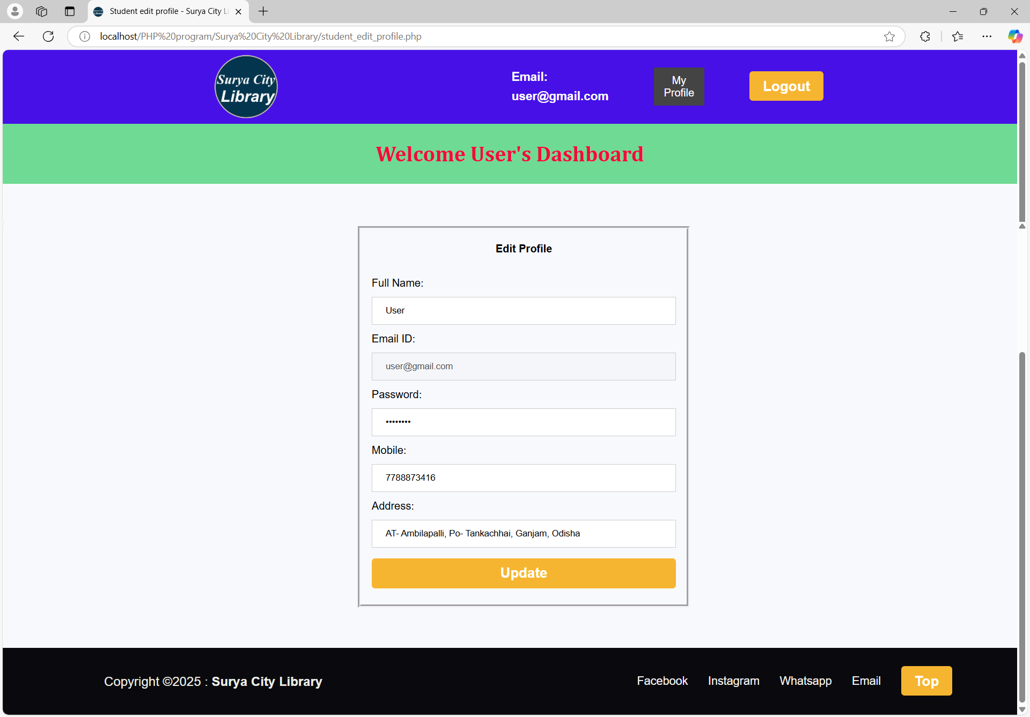

Slide 18
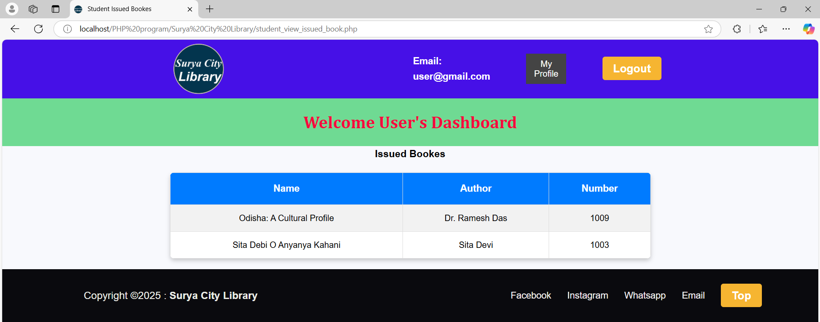

Slide 19
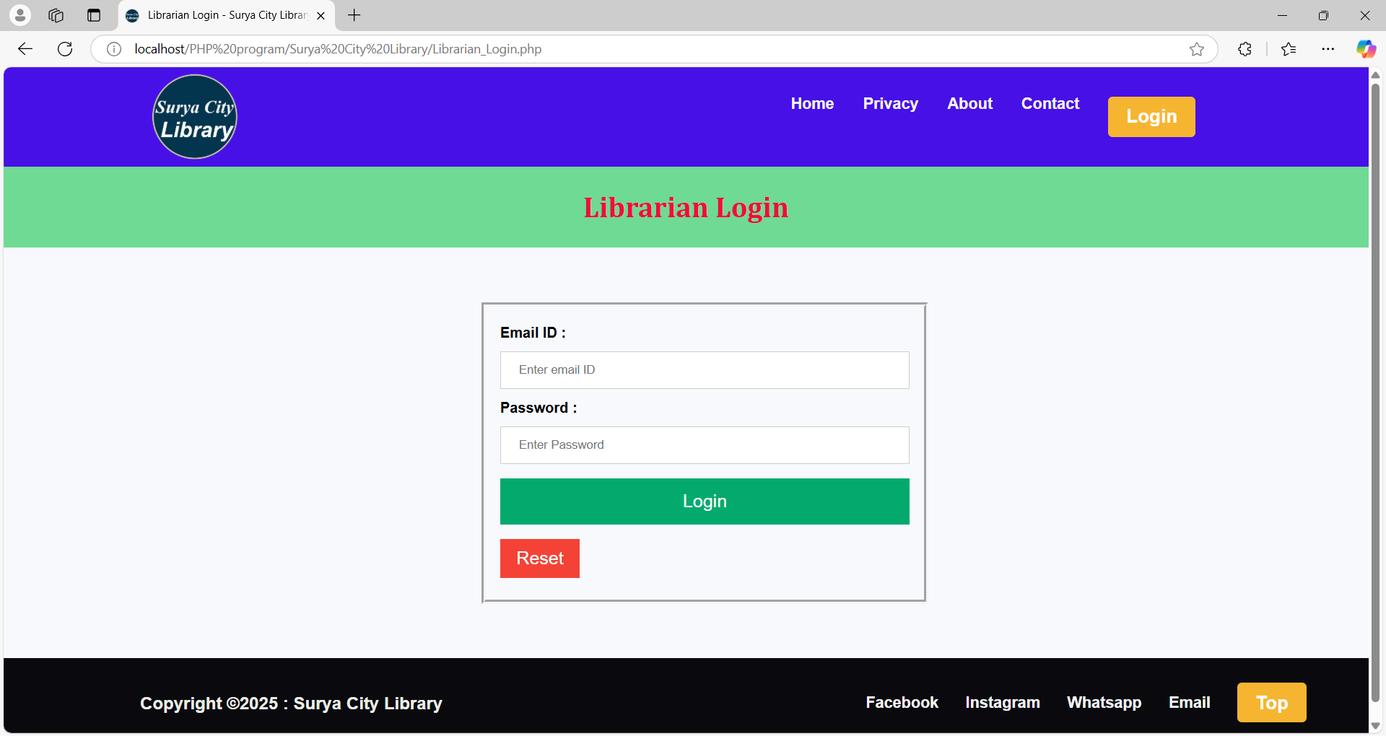

Slide 20
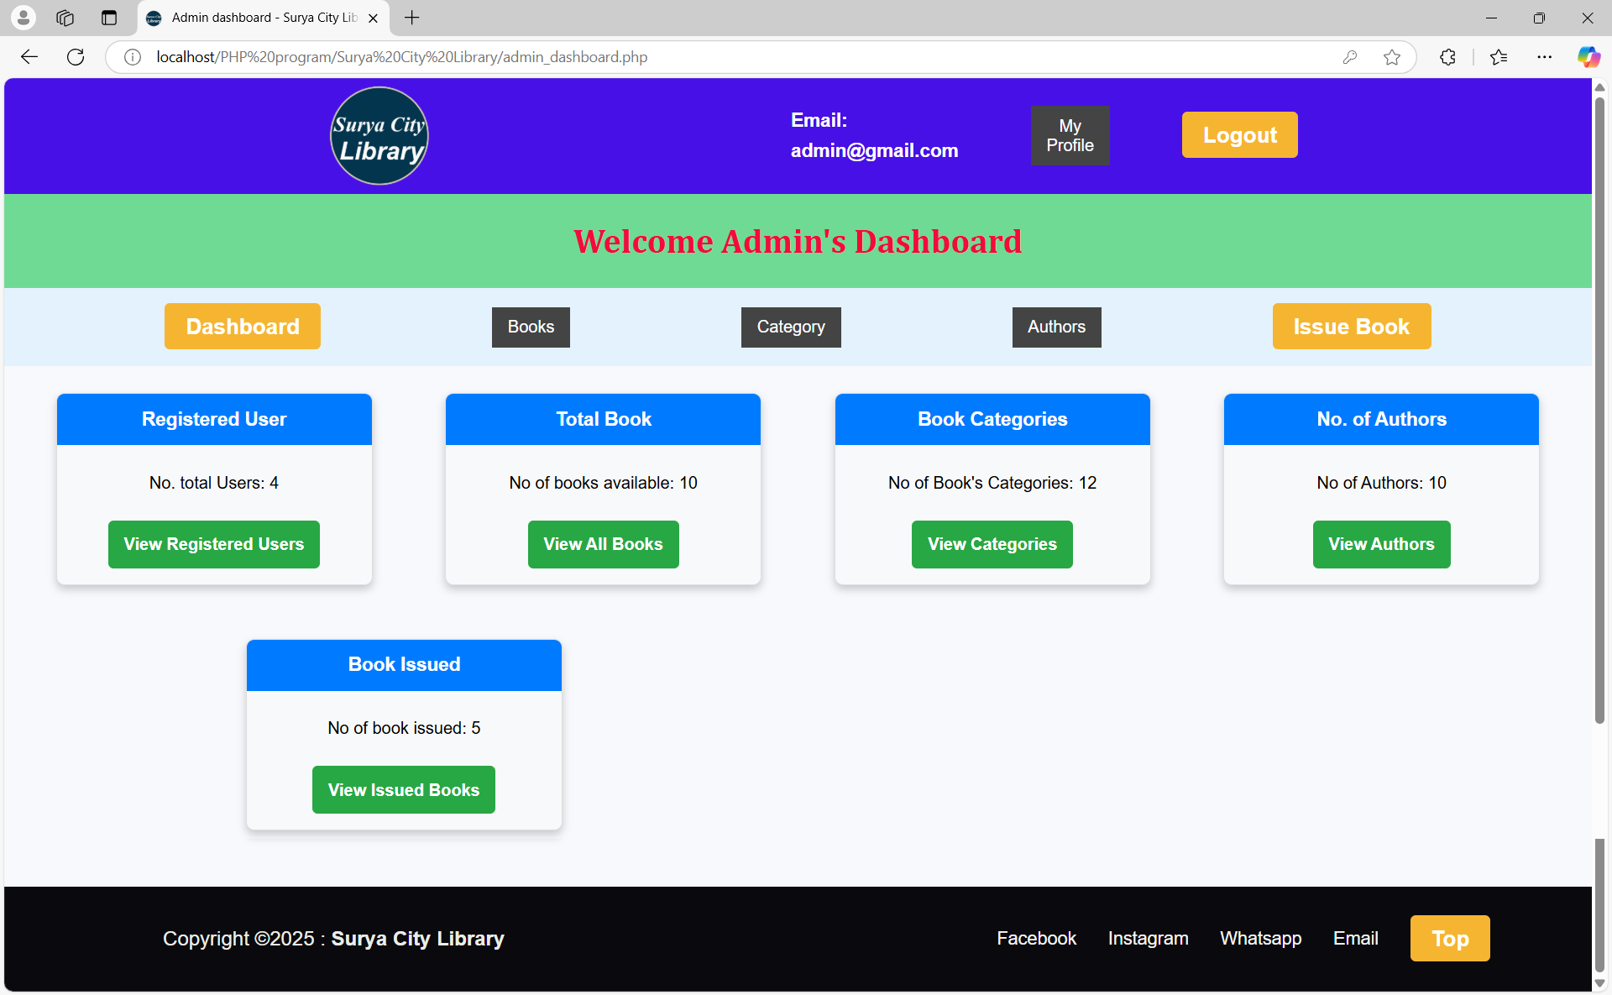

Slide 21
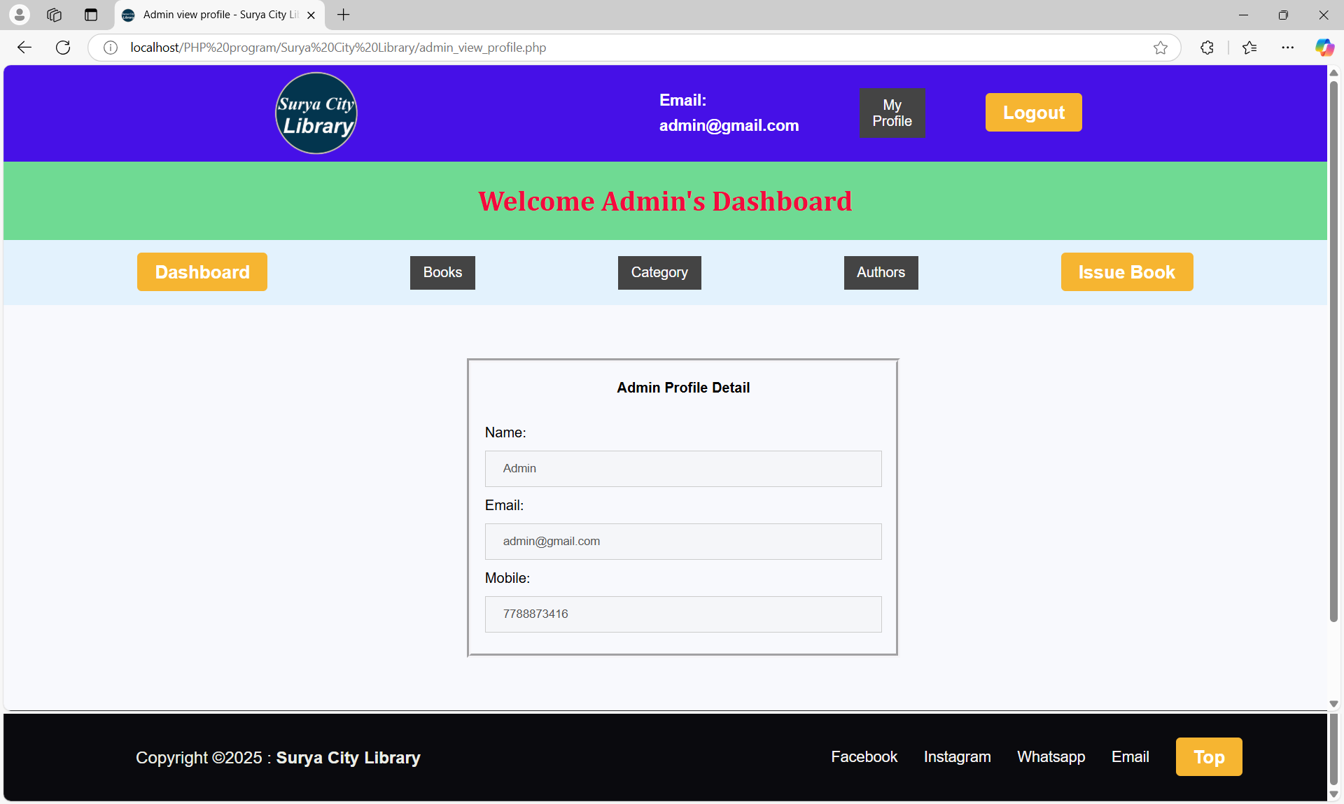

Slide 22
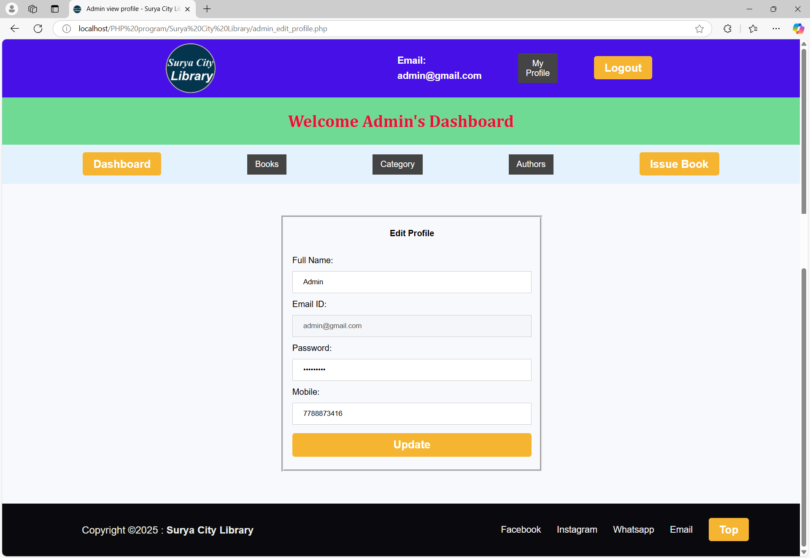

Slide 23
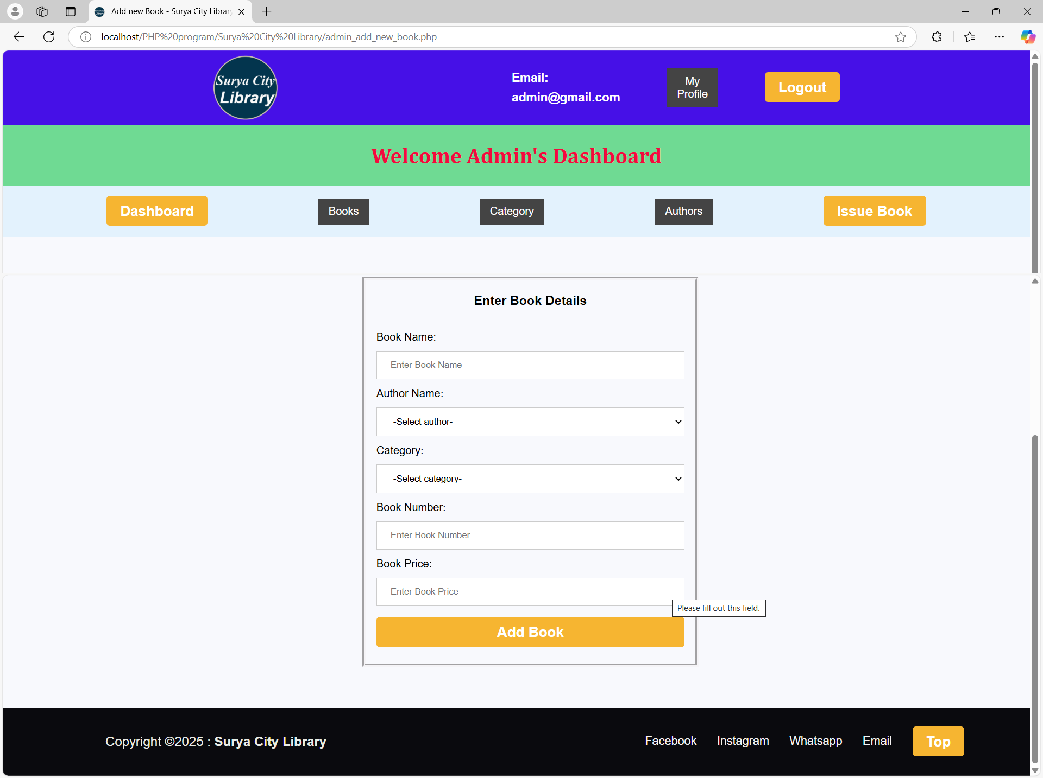

Slide 24
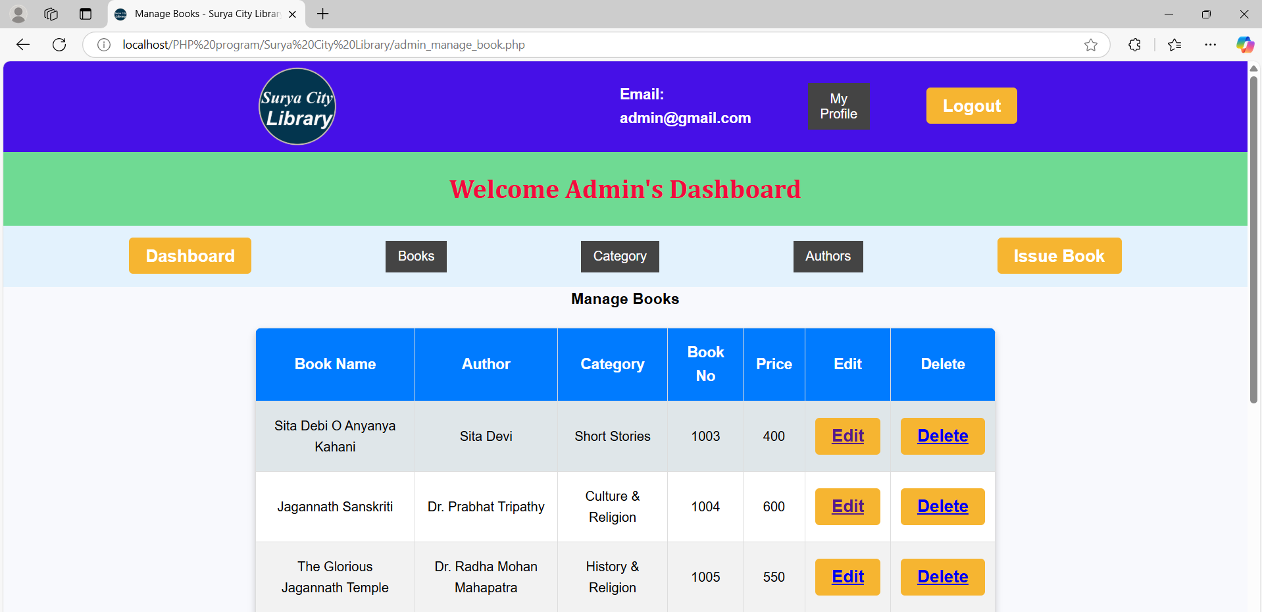
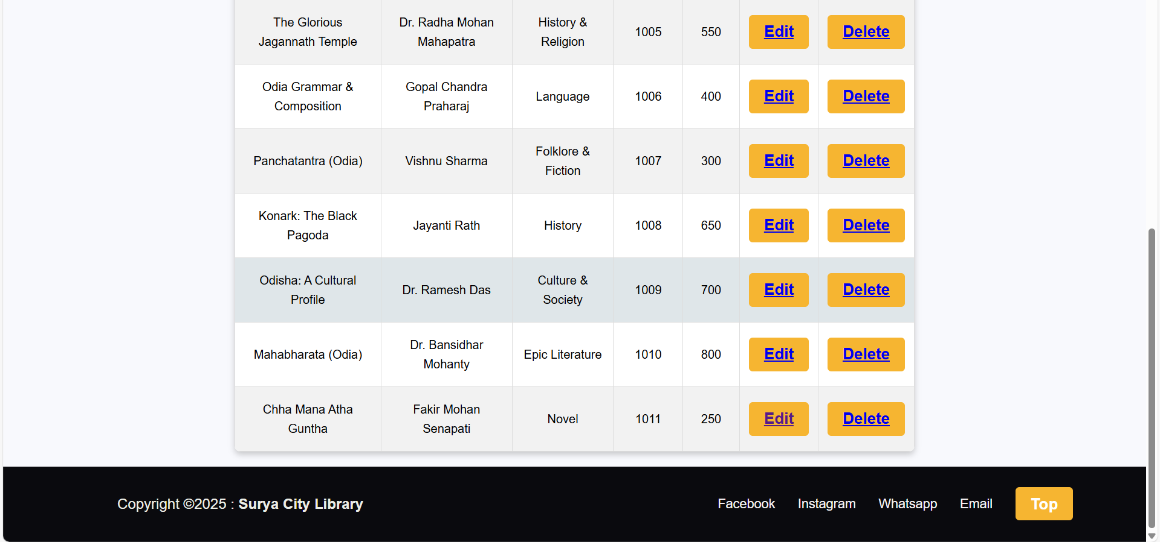

Slide 25
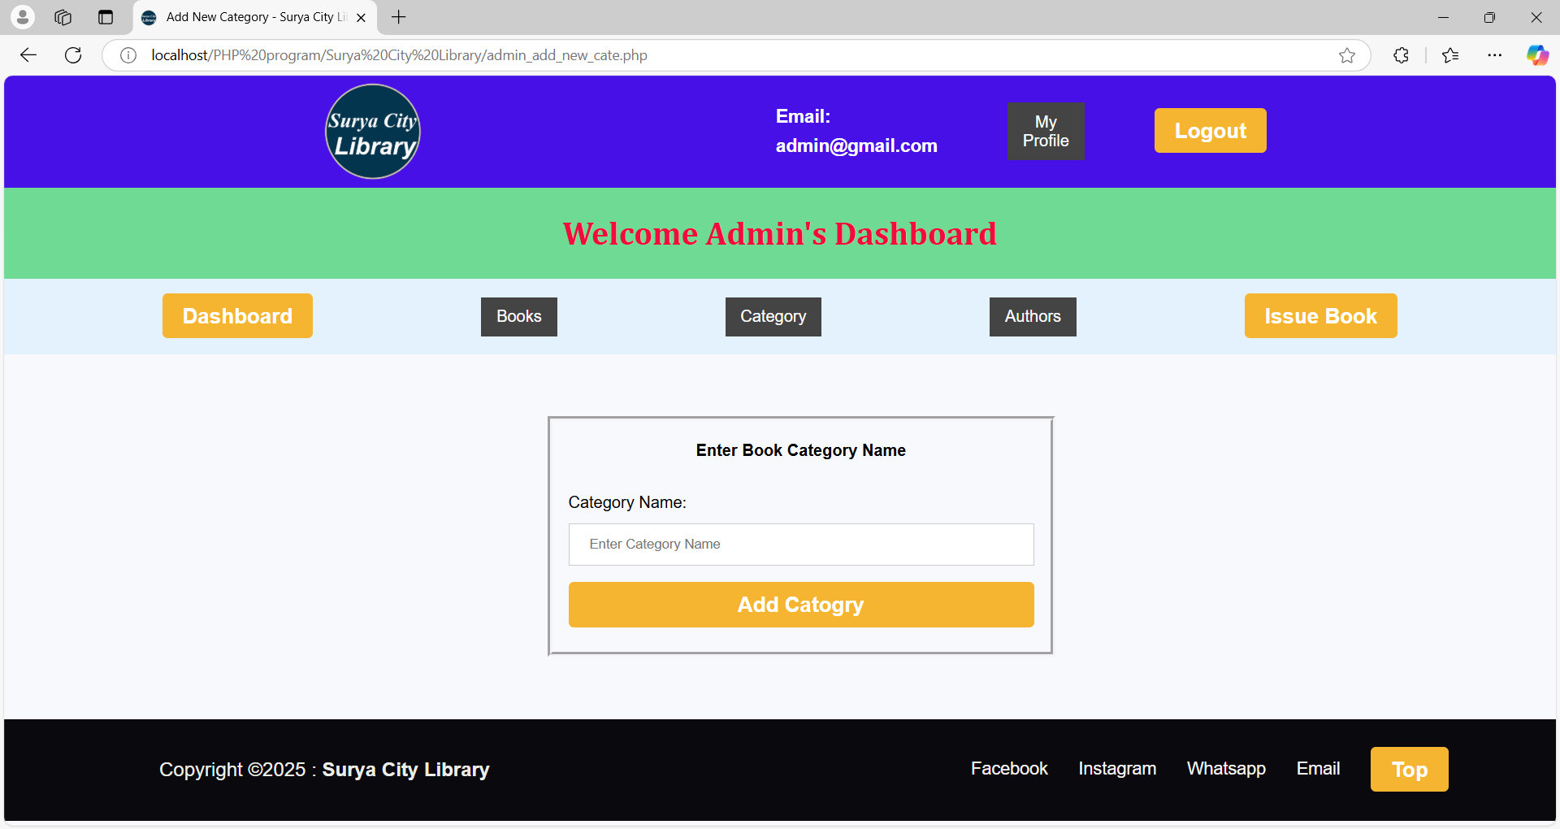

Slide 26
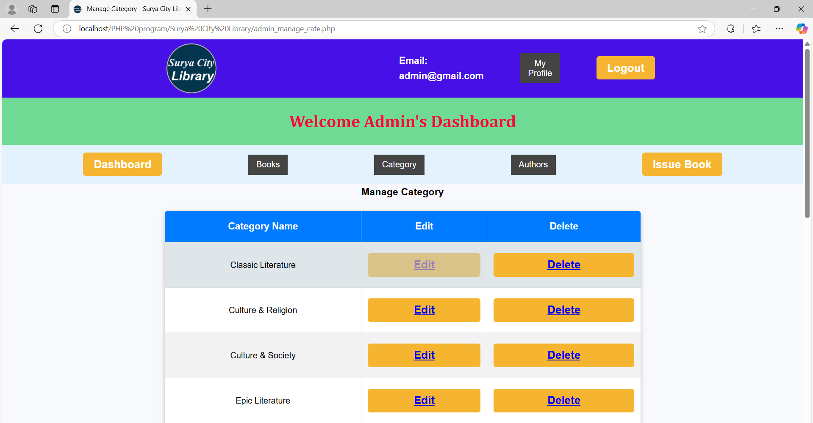
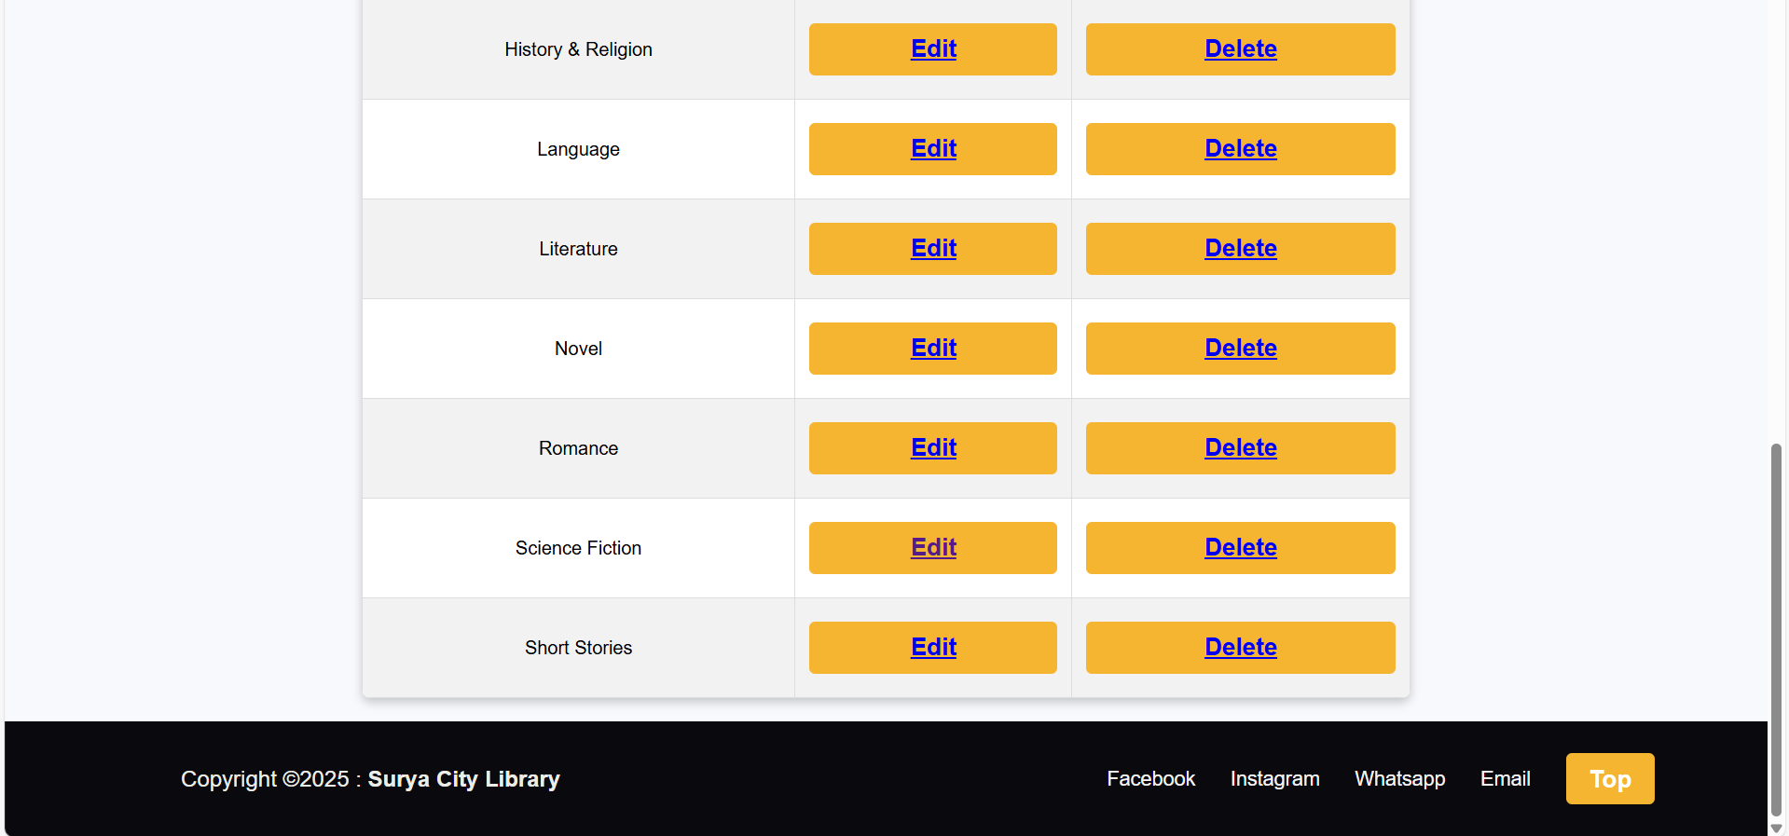

Slide 27
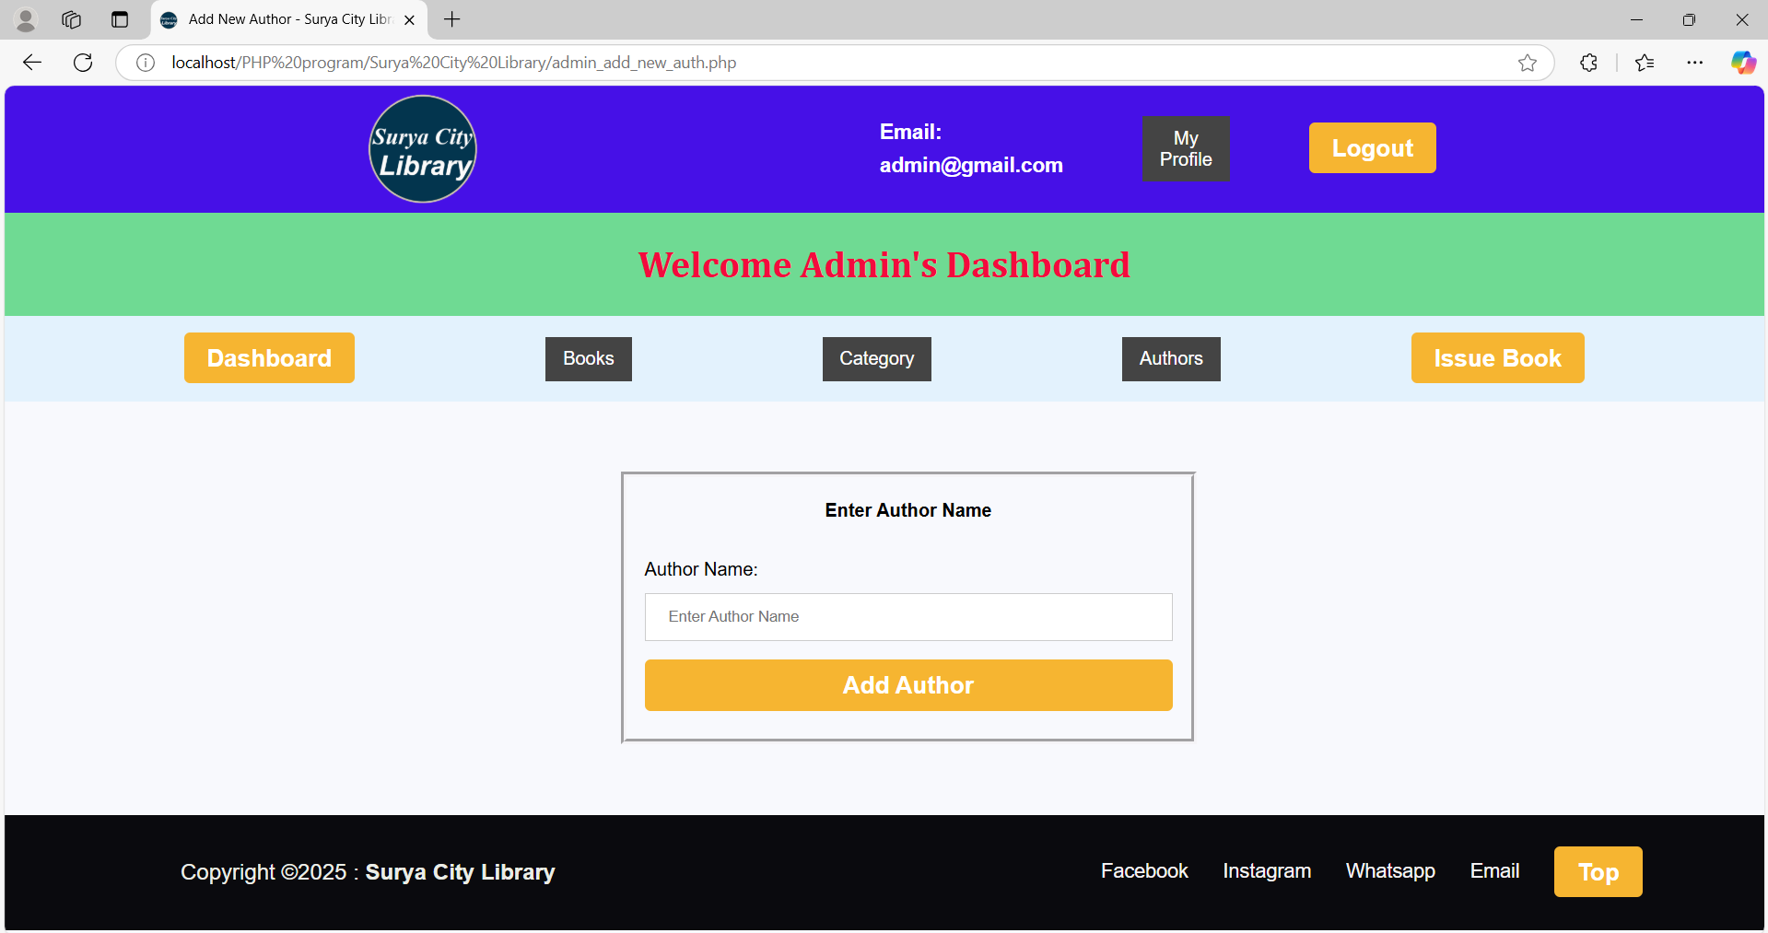

Slide 28
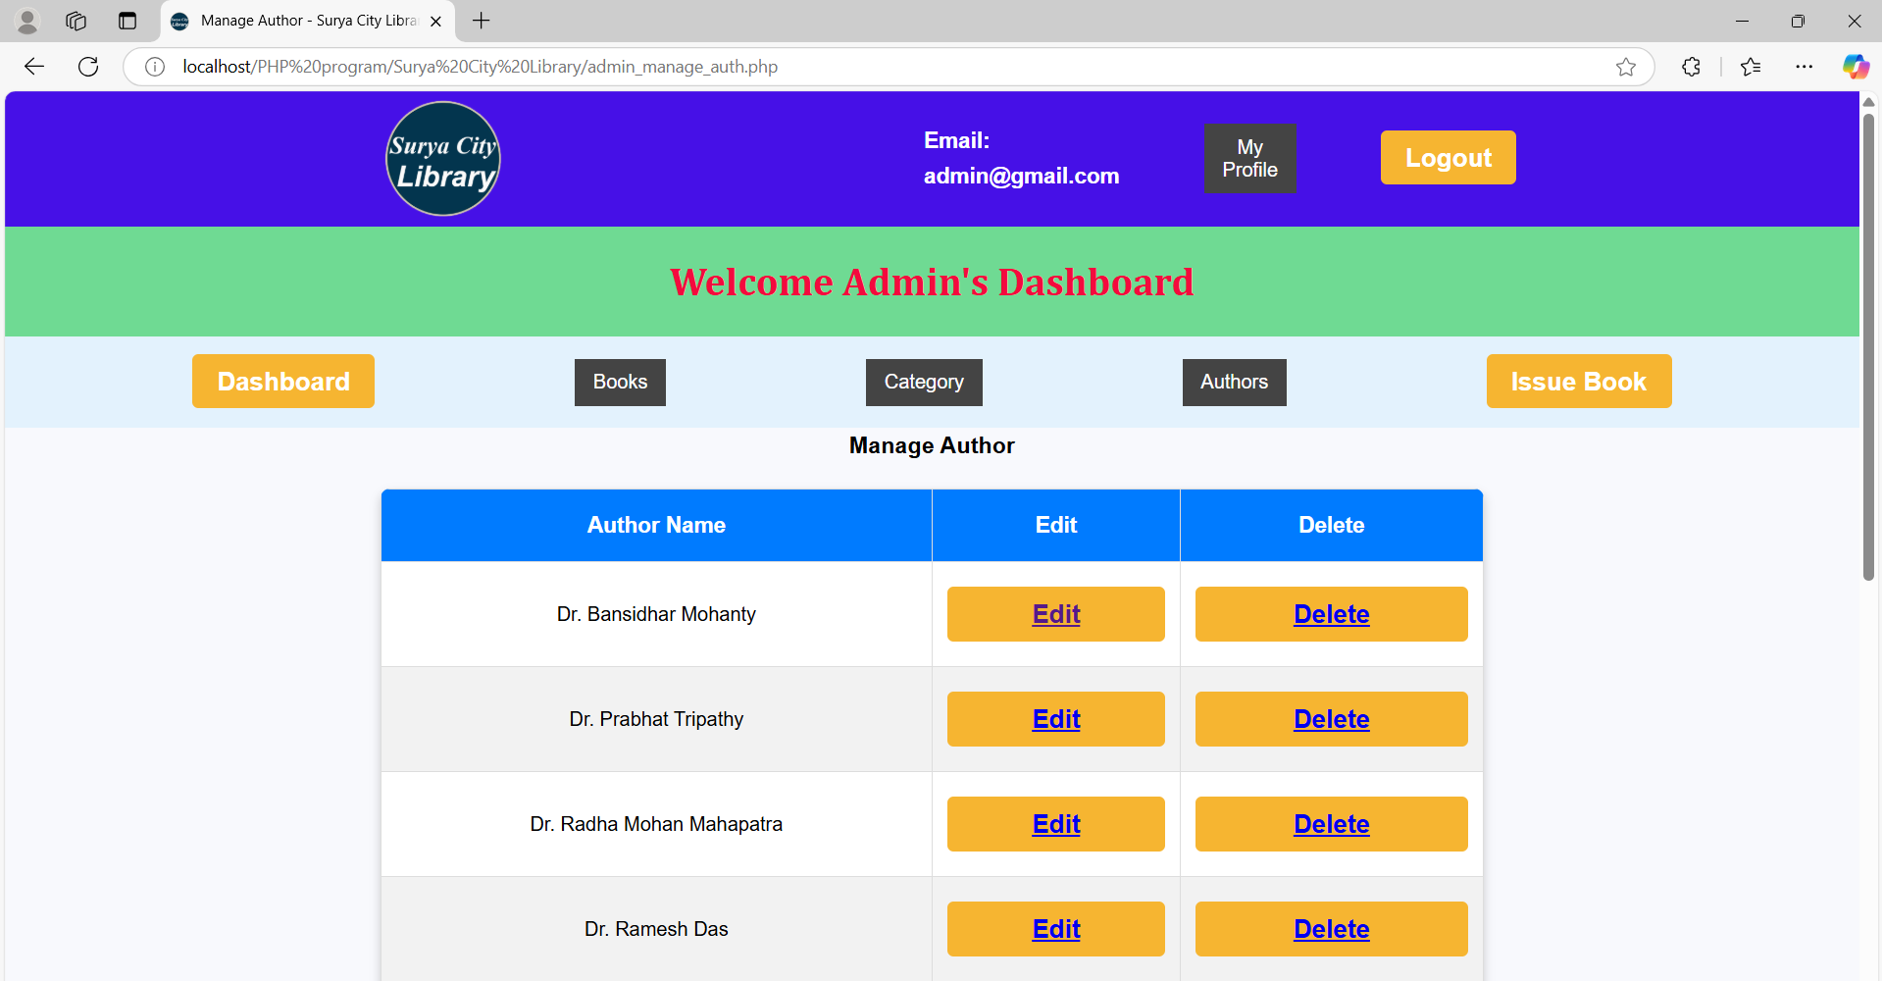
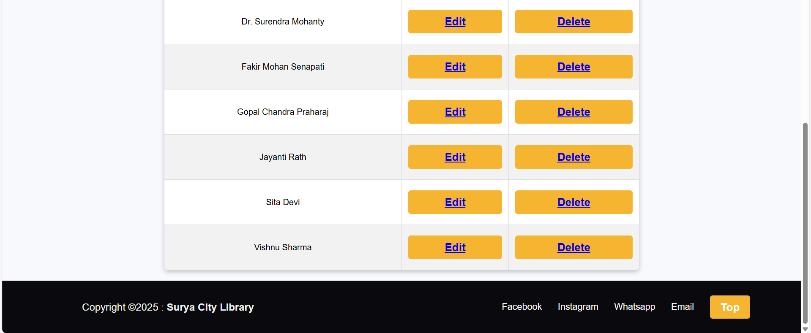

Slide 29
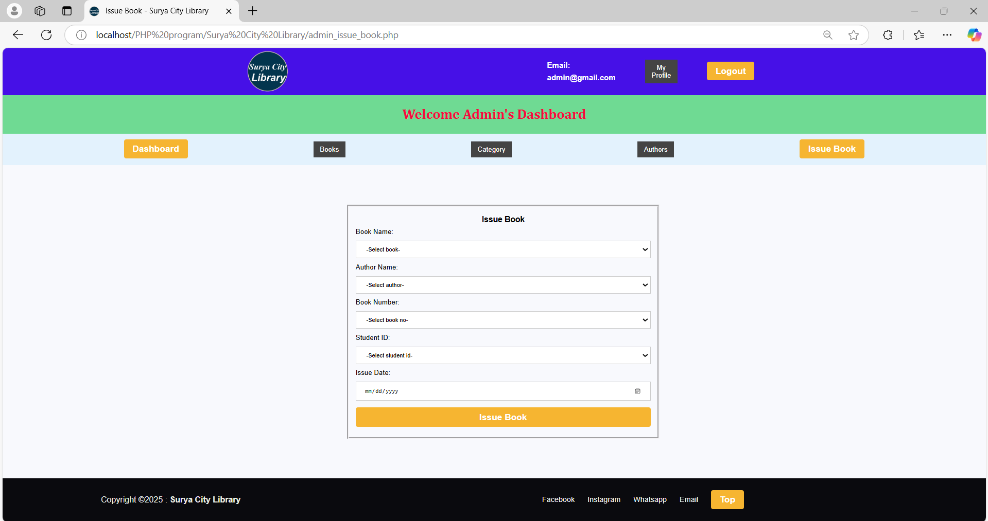

Slide 30
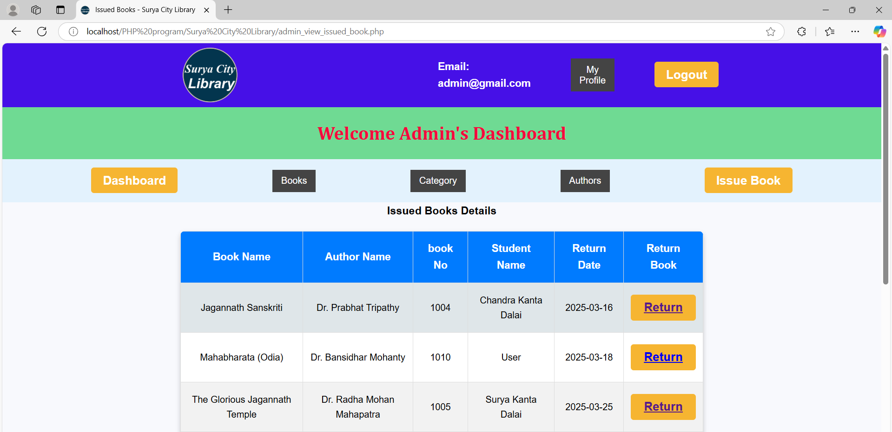
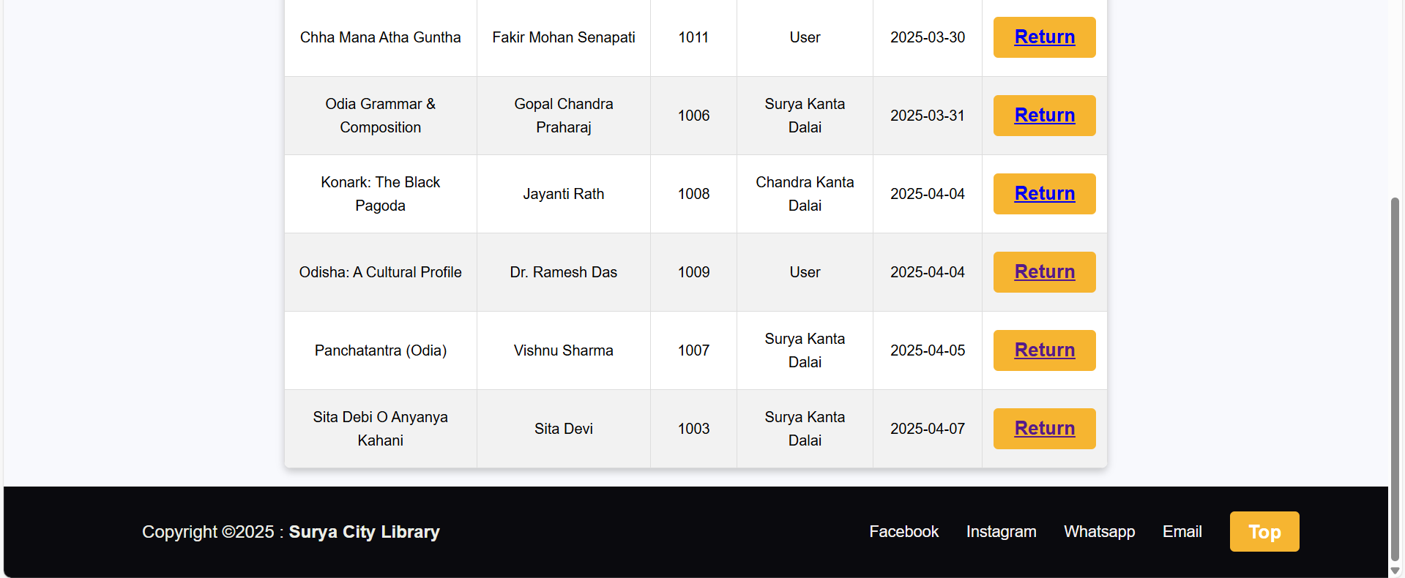

Slide 31
Future Scope
Integration of AI and Machine Learning - AI-powered book recommendation systems based on user reading history. Smart chatbots for automated query resolution and assistance.
Cloud-Based Library - Cloud platforms for remote access and scalability. Enhanced security and backup options to prevent data loss.
Mobile Application Development - Developing an mobile app for easier access to books, issuing requests, and account management. Integration of push notifications for due dates, new arrivals, and announcements.
Digital and E-Library Expansion - Support for e-books, audiobooks, and digital resources.
Multi-Language - Adding multi-language support for diverse users.
Online Payment and Fine Management - Integration of online payment gateways for fine payments and book purchases. Automated fine calculation and notifications for overdue books.

Slide 32
Advantages
Efficient Book Management - Automates book tracking, issuing, and returning processes, reducing manual work.
Time-Saving - Speeds up operations by allowing users to search for books, authors, and availability instantly.
Reduces Errors - Eliminates human errors in record-keeping, book issuance, and return tracking.
Data Security and Backup - Protects library data with access control and regular backups, preventing data loss.
Multi-User Access - Allows multiple users to access and manage resources simultaneously.
Real-Time Tracking - Monitors book availability, overdue books, and user activity in real time.
Report Generation - Generates detailed reports on Available books, issued books for better decision-making.

Slide 33
Disadvantages
Initial Setup Cost - Implementing an LMS requires investment in software, hardware, and training.
Technical Issues - System failures, bugs, or server downtime can disrupt library operations.
Learning Curve - Staff and users may require training to understand and use the system effectively.
Security Risks - If not properly secured, data breaches or unauthorized access can compromise library records.
Dependency on Internet & Power - Cloud-based or online LMS requires stable internet and power supply to function properly.
Maintenance & Updates - Regular software updates and maintenance are required to keep the system running smoothly and securely.

Slide 34

Conclusion
The Library Management System successfully automates and enhances the efficiency of library operations. It provides a user-friendly interface for students, and librarians to manage book borrowing and returns. The system significantly reduces manual work, improves book tracking, and enhances user accessibility through features.

Slide 35


Slide 36
The End
Thanks

